Slide 1
SECURE DATA HIDING IN IMAGES USING STEGANOGRAPHY
CAPSTONE PROJECT
Presented By:
Student Name : P.KALPANA
College Name & Department : SRI INDU COLLEGE OF ENGINEERING AND TECHNOLOGY (ECE)

Slide 2
OUTLINE
Problem Statement
Technology used
Wow factor
End users
Result
Conclusion
Git-hub Link
Future scope

Slide 3
Problem Statement
With the rise of digital communication, ensuring the confidentiality of sensitive information has become crucial. Traditional encryption methods can attract attention, making data transmission a potential target for hackers. This project focuses on utilizing steganography, a technique that embeds secret data within images, making it virtually undetectable and enhancing data security.

Slide 4
Technology used
The project is implemented using Python, leveraging libraries such as OpenCV for image processing and cryptographic modules for secure data embedding. The Least Significant Bit (LSB) technique is used to hide information within pixel values, ensuring minimal distortion of the original image.

Slide 5
Wow factors
Unlike traditional encryption, which makes data transmission obvious, steganography conceals information within images, making it nearly impossible for intruders to detect. The method ensures secure, undetectable data exchange without raising suspicion, making it a powerful tool for cybersecurity.

Slide 6
End users
This project benefits cybersecurity professionals, intelligence agencies, journalists, and individuals seeking secure communication. It can be used in confidential corporate exchanges, secure government communications, and covert information sharing.

Slide 7
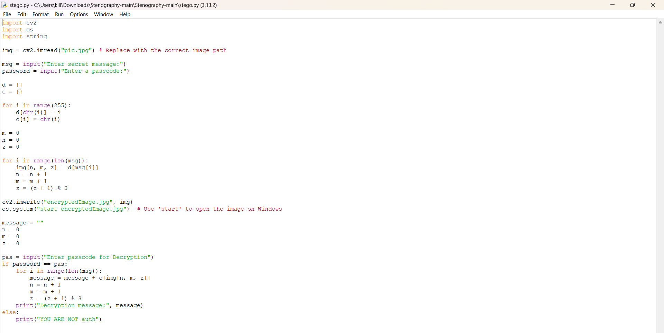
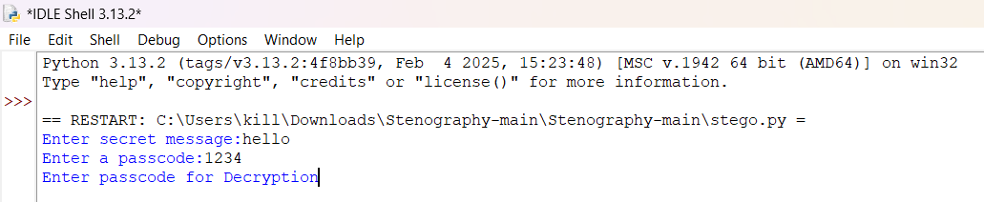

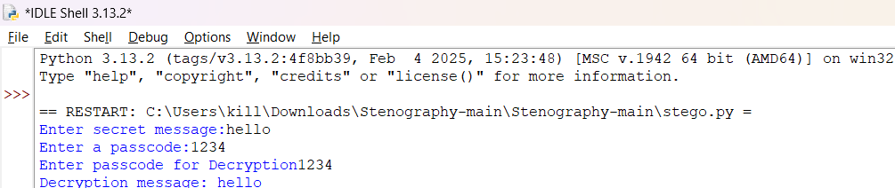

Results

Slide 8
Conclusion
Steganography provides a robust method for secure data transmission without alerting potential attackers. This project demonstrates an efficient way to embed and extract information from images, highlighting its significance in modern cybersecurity.

Slide 9
GitHub Link
https://github.com/Kalpana-1109/edunet_project.git

Slide 10
Future scope(optional)
The project can be enhanced by incorporating AI to detect steganographic attacks, improving robustness against steganalysis. Additionally, future implementations can explore higher-order embedding techniques, support for different media types (audio and video), and blockchain integration for secure verification of hidden data.

Slide 11
THANK YOU

